Slide 1



The experiment in hand
6500 items
27 labels / senses
10 annotators
Each annotator choose/vote one label/sense for one item
Each vote is worth 0.1

Slide 2
The ‘voting’
1 vote
4 votes
2 votes
3 votes

Slide 3
Transfer to Binary
This is something we decided to do …
1 vote
4 votes
2 votes
3 votes
‘Alpha Threshold’ > = 0.3 (i.e. 3 votes)
Interpretations: We define a sense or label as having received a 'significant' number of votes if it surpasses the alpha threshold nd we denote it as 1, 0 otherwise

Slide 4
Pairwise comparison
351 possible pairs
27 labels / senses
Combination: For pairs (combining 2 items at a time) from a set of 27 items, the number of unique combinations can be calculated using the combination formula:
Number of combinations=27! / (2! *(27−2)!)
Number of combinations = 351

Slide 5


What Is Nelson Looking For?
One single item
“It is obviously sense 1 (synchronous)”
“Wrong! It is sense 5 (result) for sure!”
Nelson
In this instance, there is a sense confusion between sense1 and sense 5
Nawar
We define 'Sense Confusion’ (between the three of us) as the scenario where two senses are deemed confused if both receive a significant number of votes for a specific instance.
We aim to identify pairs among the 351 combinations where sense confusion is statistically significant.
Remember: * ‘Alpha Threshold’ > = 0.3 (i.e. 3 votes)
* Comparing 1 pair at a time

Slide 6
Statistical Methods and Contingency Table
* Chi squared and p value
* Fisher exact test
* Yule’s Q test
Proposed indicates
Mutual information (WIP)
Something something (WIP)
 |  | Sense i
 |  | 0 | 1
Sense j | 0 | count | count
 | 1 | count | count

Slide 7
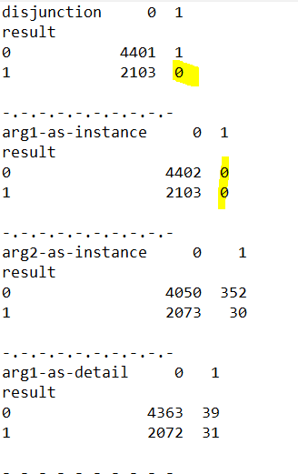
Our contingency table
* Chi squared and p value
* Fisher exact test
* Yule’s Q test
Proposed indicates
Mutual information (WIP)
Something something (WIP)
Having zero count in contingency table prevents calculating some of the statistical methods.
- directly prevent: Yule’s Q does not allow zero count in the contingency table
- indirectly prevent: for Chi-squared we derive another table (Expected table) and this one should not have zero count cells

Slide 8
Chi squared and P value
)
Our Interpretation:
‘sense confusion’ === P-value < 0.05
‘sense confusion’ === reject the null hypothesis of indolence
‘sense confusion’ === not indepence
‘sense confusion’ === depenent
‘sense confusion’ === They have the same binary values (1,1) (0,0)

Slide 9
